Slide 1







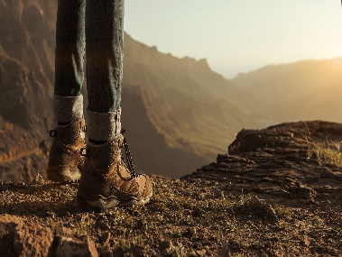
Slip on a rock
Go Back 2
Enjoy the View
Croo
The Hiking Game
End
Take
Croo
Card
Cholla - 2 Croo
Slip on a rock
-1 Croo
Gettng Tired
-1 Croo
LeFt Gear
Go Back 2
Enjoy the View
Enjoy the View
Croo
Challenges
Croo
Counters
Blister
-2 Croo
Lose Gear
-1 Croo
Summit
+ 1 Croo
Take
Croo
Card
Take
Croo
Card
Enjoy the View
Litter
- 2 croo
Forgot Water
-1 Croo
No Food
-2 Croo
Fall In Stream
Go Back 2
Enjoy the View
Start
Take
Croo
Card
Black in the shed?
-2 Croo
Take
Croo
Card

